Slide 1

MULTI FACTOR INVESTING

Slide 2




The Team
Johanan Anton Pranesh
I’m a second year Master’s in Financial Engineering candidate at Lehigh with a background in Math and industry experience in a hedge fund. My projects have been focused on Multi-Factor investing, Index development, NLP in CDS and other financial instruments, and machine learning optimization.
Sisheng Liang
MFE’25
Kshitij Bhandari
MFE’26
Vincent Batten
MFE 4+`1

Slide 3
Overview

Slide 4
Introduction
Factors:
Characteristics that explain the return of equities and influence variations in portfolios
For this project, we are focusing on the Fama-French factors such as size, value, and market risk
Multi-factor investing :
An investment strategy that combines multiple factors to achieve specific investment goals, like higher returns or lower risk
It enhances diversification and seeks to optimize portfolio performance

Slide 5
Objectives
To create a systematic framework for multifactor investing in equities
To systematically identify, measure, and integrate factor exposure that historically drive returns.
To provide a structured approach for building diversified portfolios that are tailored to capture these factors while maximizing risk-adjusted returns.
Identify optimal rebalancing and holding period for various factor exposures

Slide 6
Goals:
Using Monte Carlo simulations, learn about the expectation and variance of the portfolio for specific target exposures and compare its performance with the SP 500
Implement strategies such as hedging to note its impact on factor decay as well as on rebalancing of the portfolio
Discover new target exposures using reinforcement learning that relies on back tested information which offer better downside protection
Understand the optimal holding period for factor combinations
Compare the effect of tax-loss harvesting, alpha signal from alternative data on performance

Slide 7
Project

Slide 8
Optimization
Minimizes the error term in portfolio returns
Ensures the portfolio's factor exposure aligns with the desired factor exposures
Optimizes the number of shares to be bought/sold
Minimizes transaction costs
Constraints:
Weight constraints
Error constraints
Transaction costs constraint
Number of stocks constraint

Slide 9
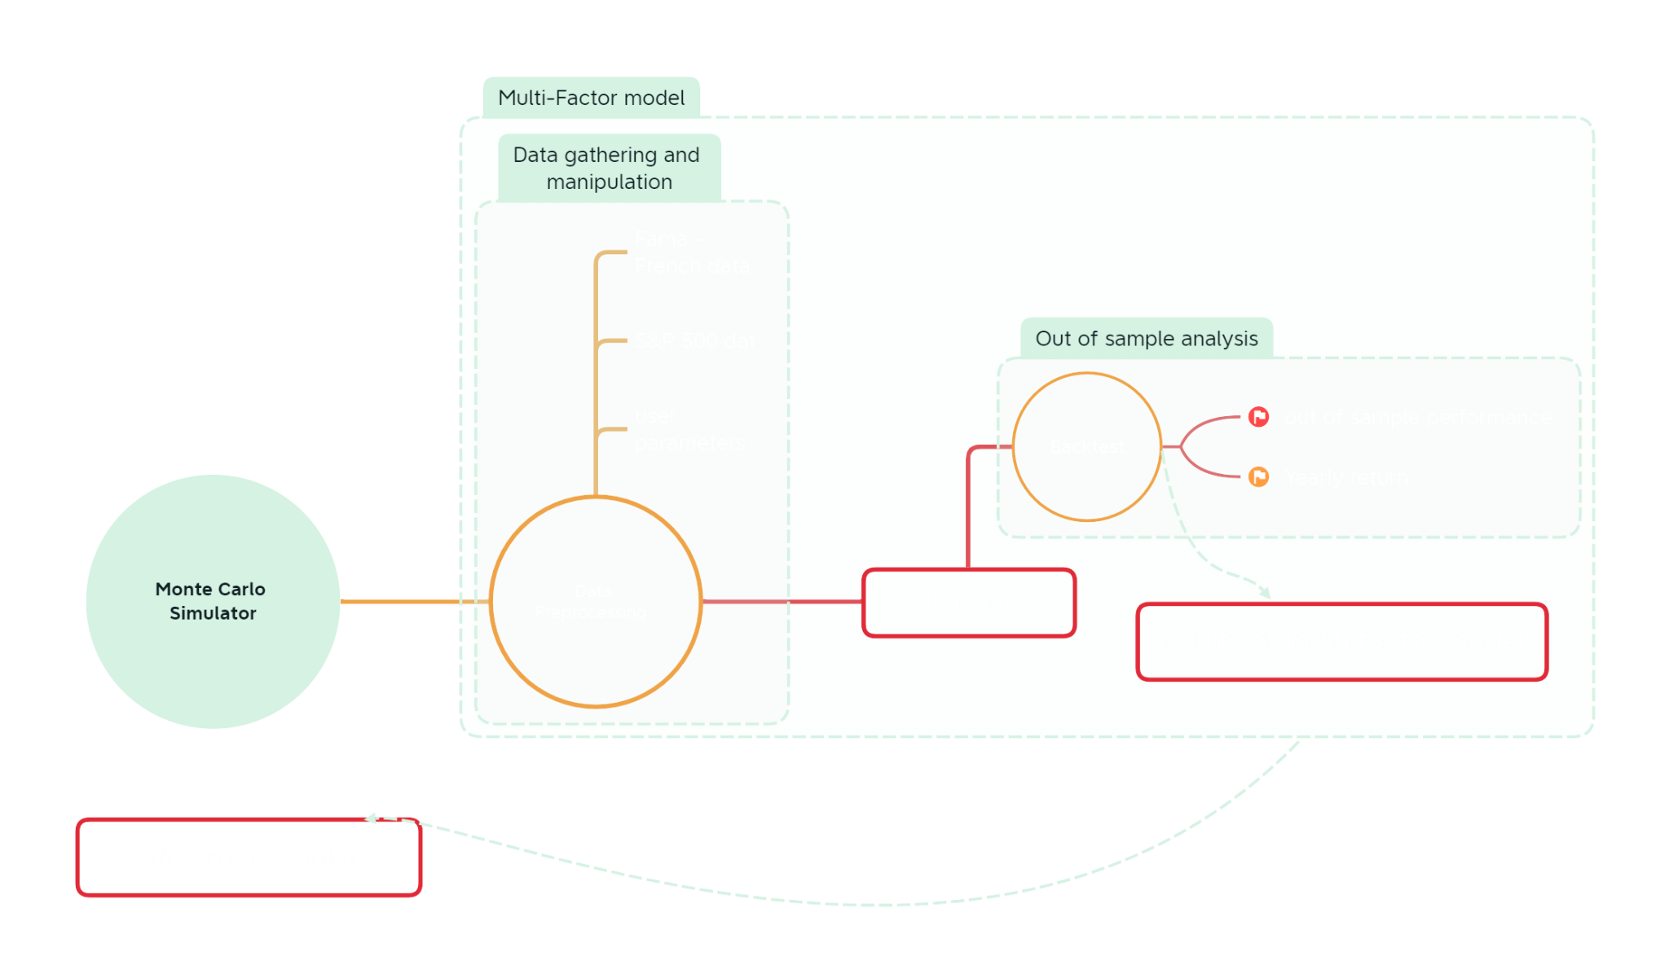

Slide 10
Findings from Monte Carlo Simulations

Slide 11
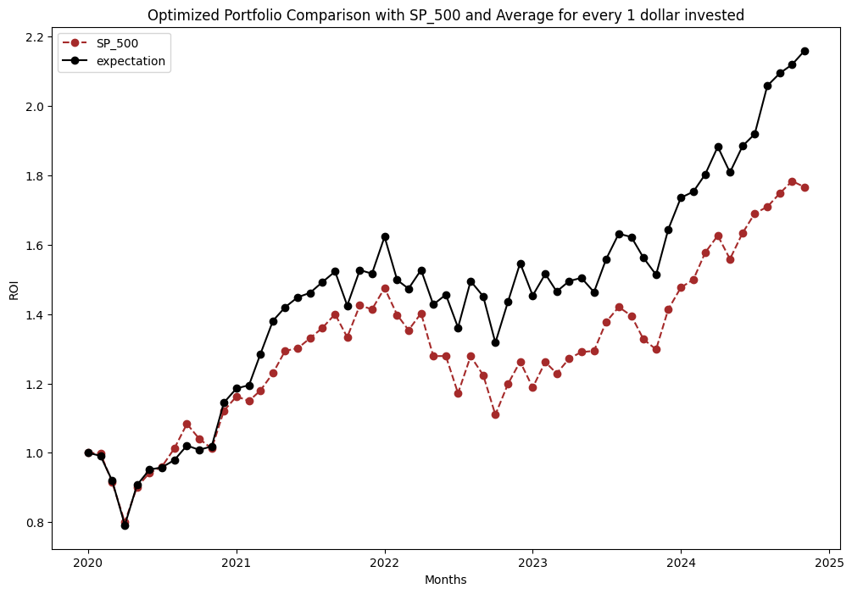
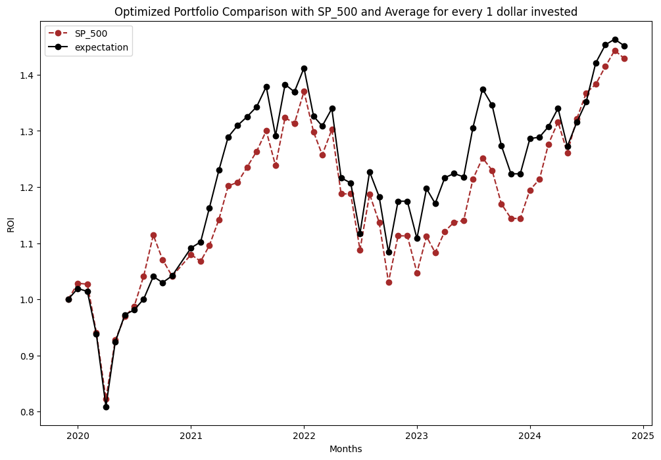
Base case (Pure market strategy)
Non-Rebalancing
Rebalancing
Notes:
Graph 1

Slide 12
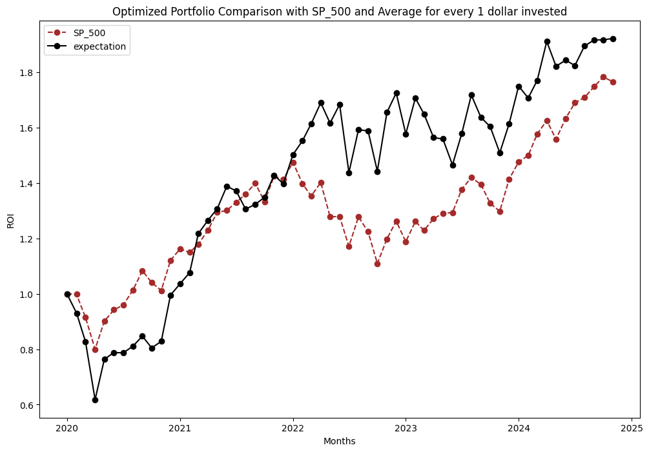
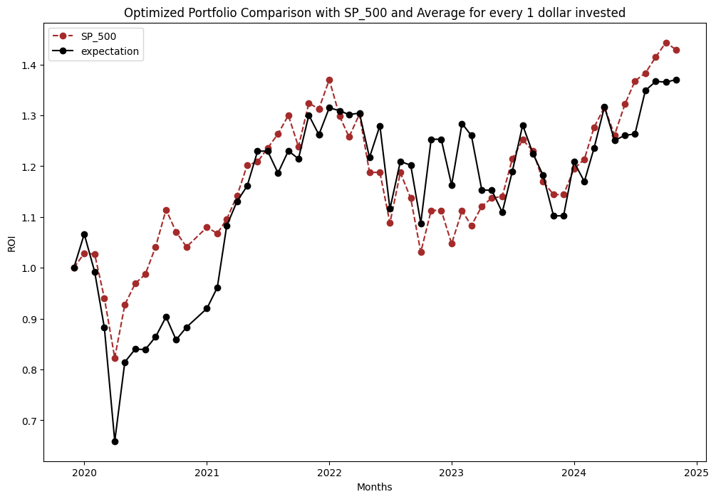
Reinforcement case (1,0.7,0.7 strategy)
Non-Rebalancing
Rebalancing
Notes:
Graph 1

Slide 13
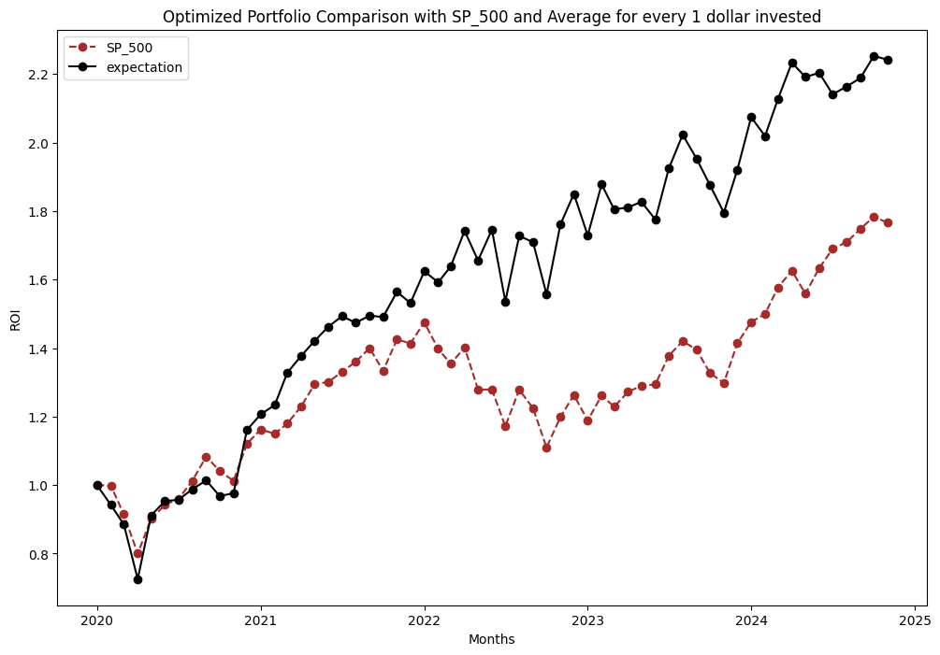
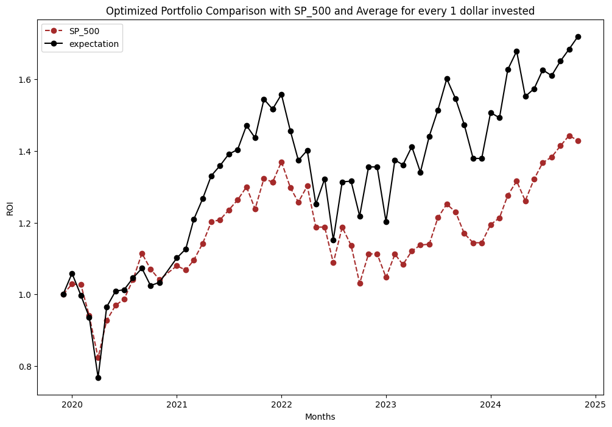
New best case (1,1,0 strategy)
Non-Rebalancing
Rebalancing
Notes:
Graph 1

Slide 14
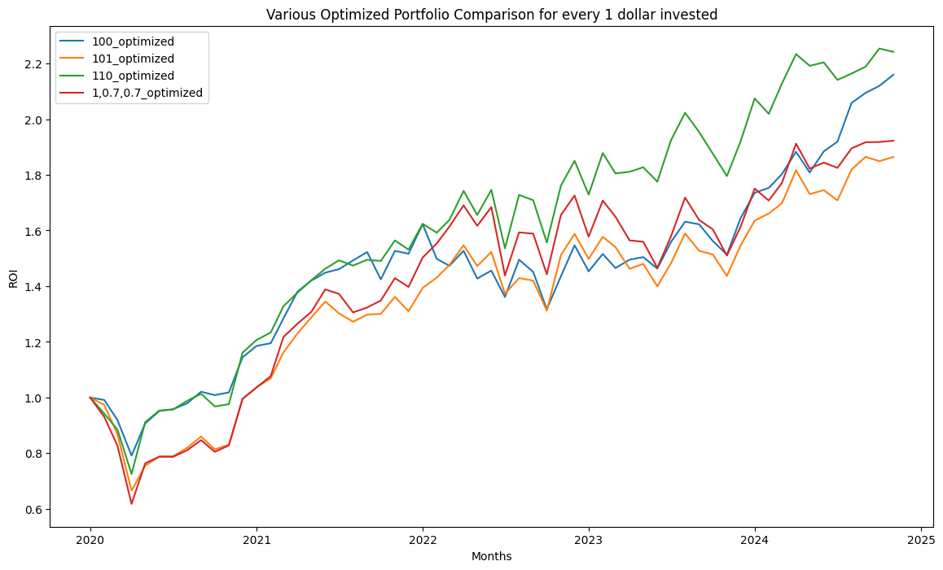
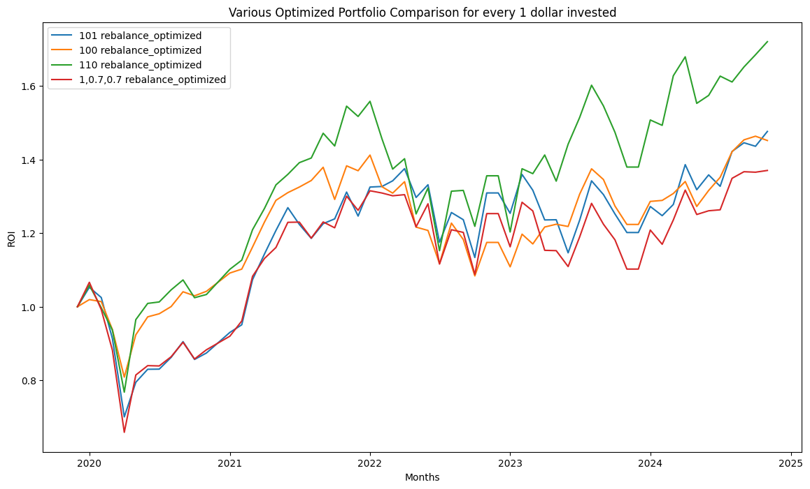
Non Rebalancing vs Rebalancing
Non-Rebalancing
Rebalancing
Notes:
Graph 2

Slide 15
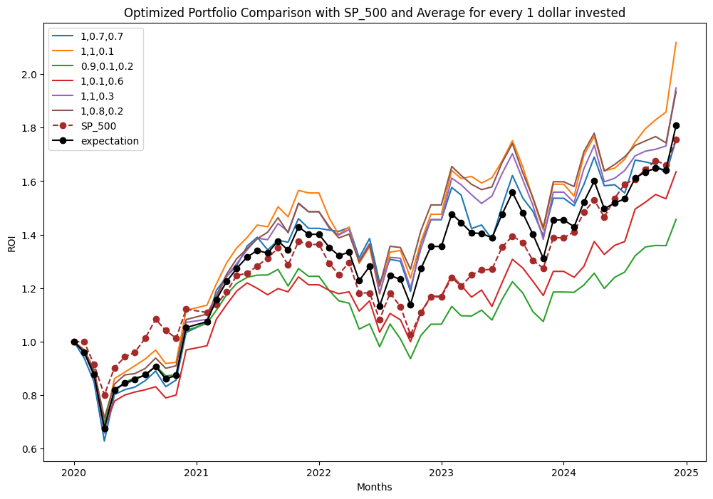
Performance of different strategies

Slide 16
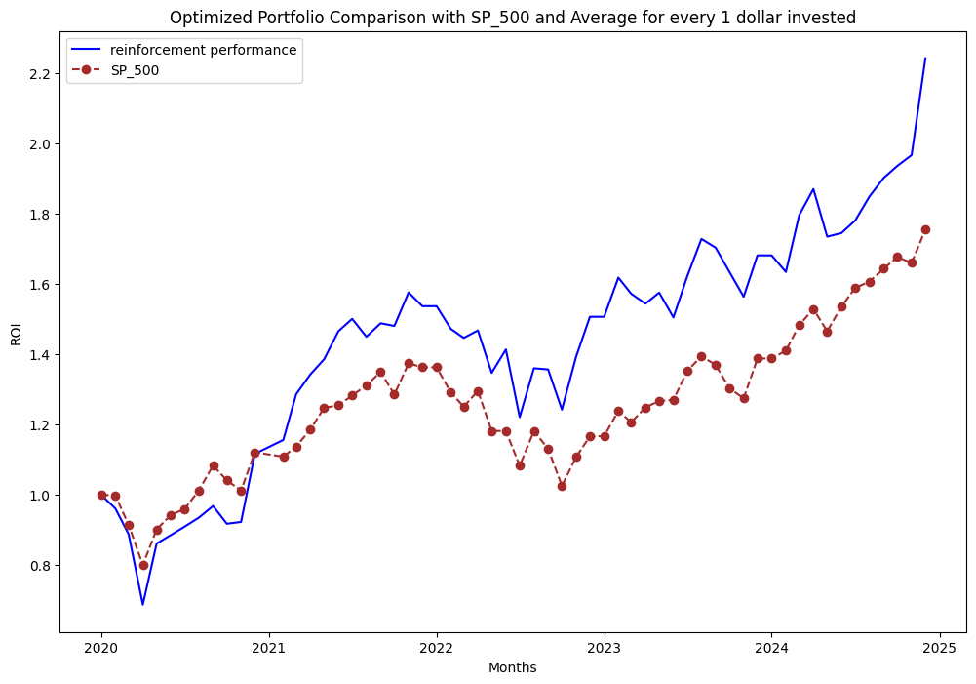
Reinforcement performance

Slide 17
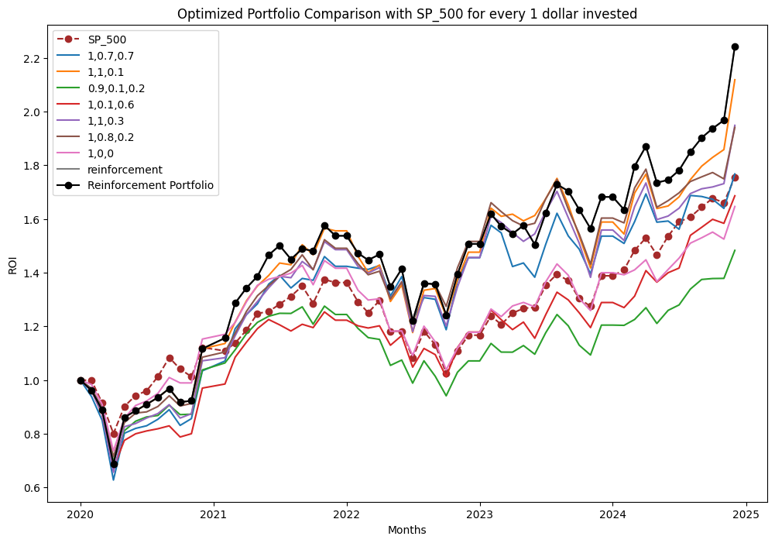
Reinforcement performance

Slide 18
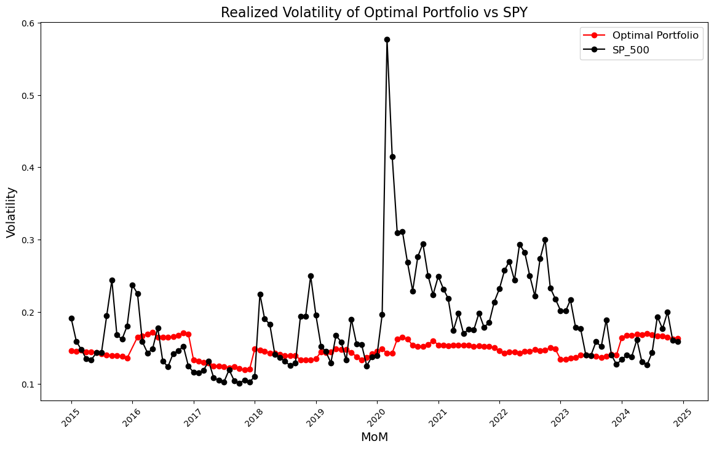

Slide 19
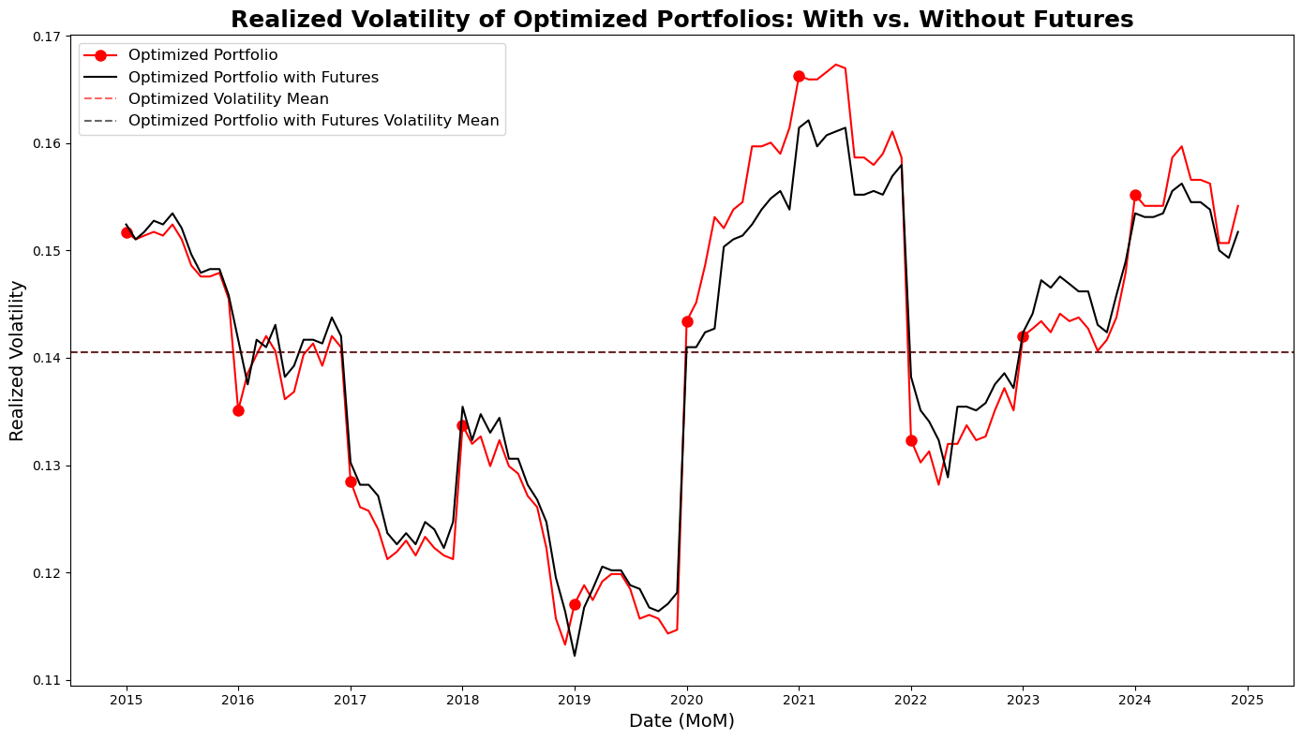
Notes:
Although the means are the same, the total standard deviation of the volatility is about .015 for the Optimized Portfolio, and about .013 for the Optimizied portfolio with futures, which is about 13% lower. As far as the volatility is when rebalancing, as we continue to integrate the RLM model to run every rebalancing date, we expect the volatility to continue to decrease as we rebalance so were excited to re run this and see how it goes.

Slide 20
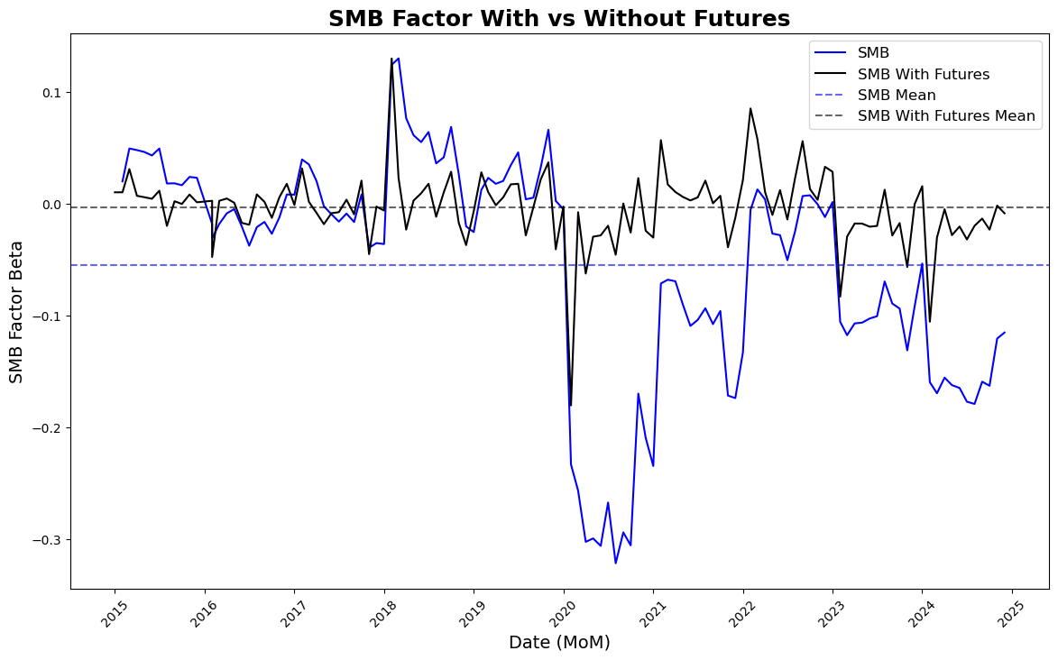

Slide 21
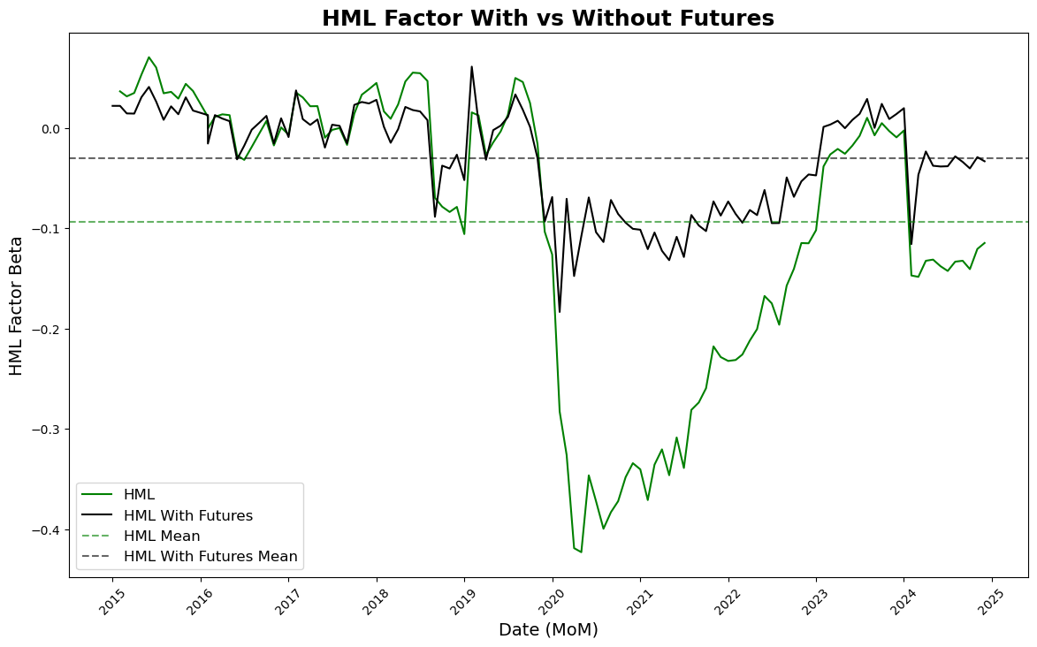

Slide 22
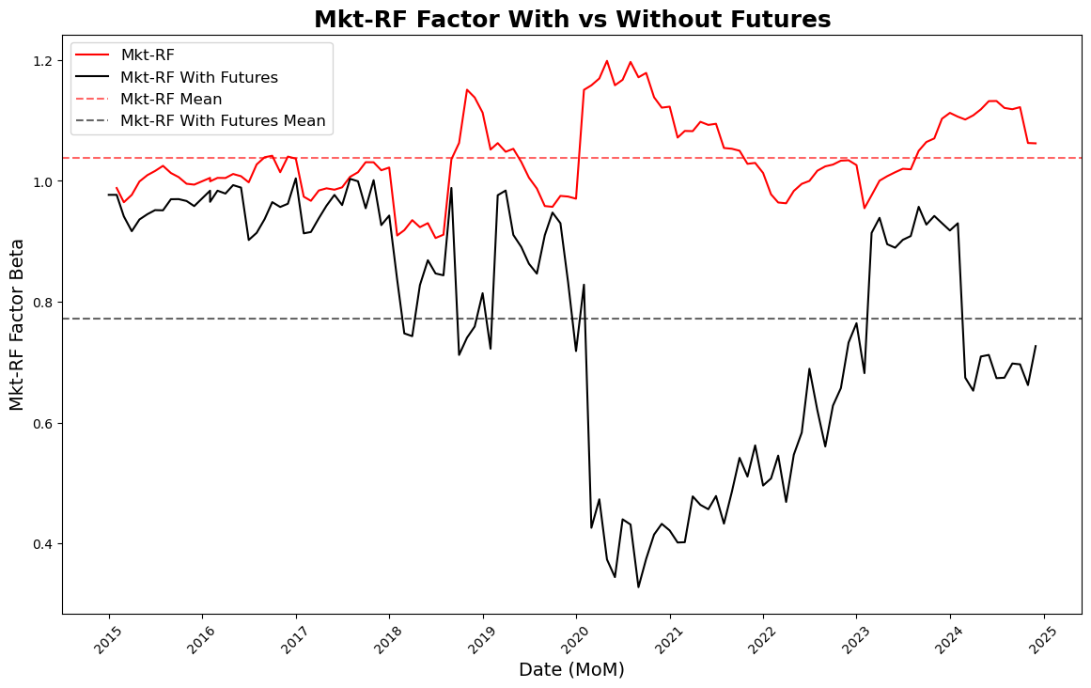

Slide 23
Alpha Signal Framework
Developed an alpha signal framework based on a dataset of news headlines
Utilized an LLM model to extract sentiment labels and their associated probabilities
Engineered features using statistical measures such as standard deviation, skewness, kurtosis, and various aggregations of existing features to create a weekly data point

Slide 24
Reinforcement Learning

Slide 25
Bandit algorithm
To find new combinations of factors that provide better downside protection compared with the benchmark
Enhanced with Monte Carlo simulations to explore new combinations and avoid previously tested options.
Prioritizes changes in factor combinations that could yield improved downside protection.
Uses ϵ-equalizing algorithm to have higher exploration & lower exploitation
Avoids redundancy and concentrates computational efforts on discovering new, promising strategies.

Slide 26
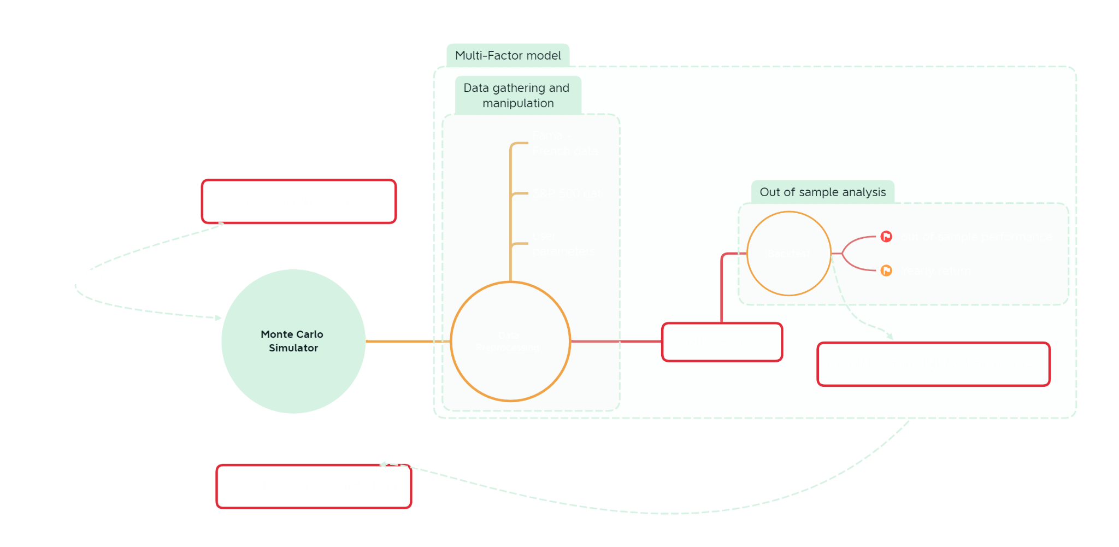

Slide 27
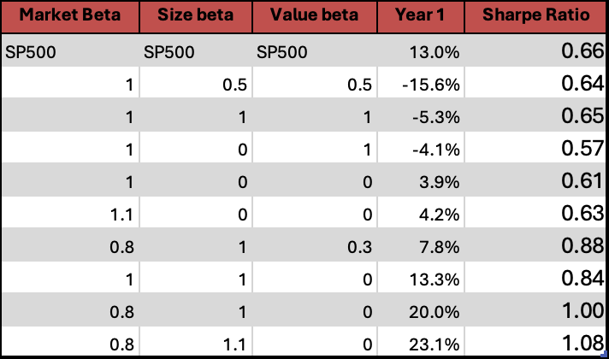
Results from Reinforcement Learning

Slide 28
Strategies
Futures Hedging
Tax loss harvesting
Alpha signals from alternative data
For Enhanced Returns and Risk Management

Slide 29
Futures Hedging
Using futures on indices with the highest hedge ratios to maintain exposure to individual factors
To prevent factor decay by maintaining consistent factor weights without the need for frequent rebalancing
To protect against short-term market movements
Uses a ML algorithm to pick the optimal future from a basket of index futures

Slide 30
TLH Optimizer (Tax Loss Harvesting)
Tax-loss harvesting is a way to convert investment losses into tax savings.
Modified the Optimization Model by adding more constraints:
Identify losing positions → Find assets with unrealized losses.
Sell the losing asset → Realize a capital loss.
Offset taxable gains → Reduce capital gains or deduct against income.
Avoid the wash sale rule → Wait 30+ days before rebuying the same asset.

Slide 31
Alpha signal generator
The overall goal of this is to try to find a relationship between the sentiment analysis and our factors
If we find meaningful relationships, then we could factor this into our rebalancing strategy
It can additionally be used as a constraint as to what to sell/buy when rebalancing
Using unstructured data, we are able to identify equities that are to be avoided in our portfolio construction

Slide 32
SVRG Optimization
Objective: Minimize the error between portfolio returns and expected returns subject to constraints like:
Non-negative weights
Weight sum equals 1
Transaction cost constraints
Maximum number of assets with non-zero weights
How SVRG Enhances Optimization:
Efficient Convergence:
SVRG handles large datasets by reducing the variance in gradient estimates, leading to faster convergence compared to traditional optimization methods.
Constraints Handling:
SVRG efficiently integrates constraints such as transaction costs and weight limits, reducing the optimization complexity by using variance-reduced gradients to avoid large changes in weights.
Notes:
Johanan

Slide 33
Task completed the last 2 weeks
New system is up and running
Tax loss harvesting optimizer is designed and implemented
New project set up and outlook has been implemented
Gathered the insights requested for identifying the performance difference between different strategies
Future simulator was tested and integrated into the main functionalities

Slide 34
Current goals
To determine the optimal rebalancing interval, balancing risk and return across various factors.
To identify and develop new beta strategies that offer sustainable long-term performance and less volatility
Compare the effectiveness of rebalancing strategies like future-based hedging versus tax loss harvesting
To understand the effect of alpha signal from alternative data on betas

Slide 35
Thank you for your time
To answer any further questions, please contact:
Johanan Pranesh
johanananton@outlook.com

Slide 36
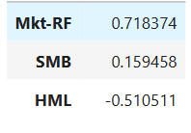
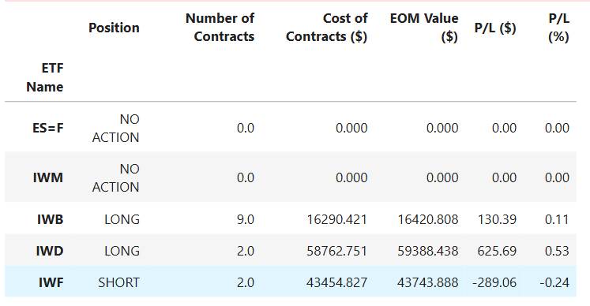
Future hedging results
Betas at 7/1/17

Slide 37
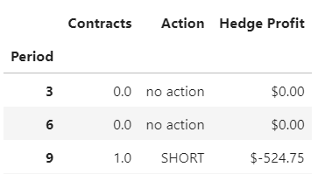
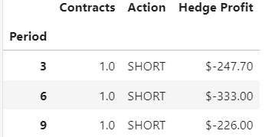
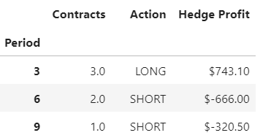
Risk Factor Size Factor Value Factor
Notes:
And then I mentioned this last week but just to show it again. Looking at period 3 here, the risk factor is close to 0% decayed in the first quarter, so no contracts are purchased, then the size factor is a little bit more decayed, closer to 1%, so 1 contract is purchased, then finally the value factor, is closer to 5%, so 3 contracts are purchased.

